Slide 1
E.EYE DRY EYE
E.EYE DRY EYE

Slide 2
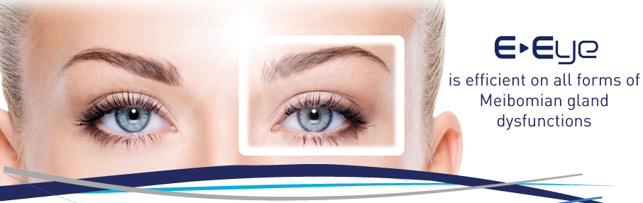

Slide 3
DRY EYE CLASSIFICATION
classification of dry eye is
1-aqueous-deficient and
evaporative (meibum deficiency)

Slide 4
Dry Eye or MGD?
DES happens when there is a deficiency in the aqueous layer of the tear film.
This can be treated with
1-artificial tears
2-ointments or
3-punctal plugs

Slide 5
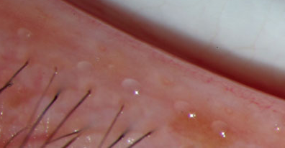
NORMAL sebum (meibum)
normally meibomian gland lies in mucocutaneous junction

Slide 6
MEIBUMS
MEIBUMS are liquid at room temperature
normal melting point of between 66 - 89 F(19-31 C)
are distributed over the ocular surface in a thin, smooth film called meibum.
This meibum functions to prevent evaporation of the aqueous layer.

Slide 7
Dry eye secondary to MGD
70% of cases of DES are actually MGD
EYE drops with preservative makes worst dry eye secondary to MGD
so prescribe artificiar tears without preservative for patient with MGD

Slide 8
Symptoms of blepharitis include
Posterir blepharitis is main cause of MGD
A burning sensation in the eyes
Dryness of the eyes
Stickiness
Itching
Photophobia (light sensitivity)
Excessive watering of the eyes
Feeling like there is a foreign body in the eye
Sty or chalazion
Blurry vision that seems to come and go

Slide 9
Meibomian gland dysfunction (MGD)
means that the glands produce either
too much or more commonly
too little oil

Slide 10
Meibomian Gland Dysfunction (MGD) ?
1-secondary to blepharitis (inflammation),
2-atrophic.
most often the glands becomes blocked because secretions become too thick.
If the glands become chronically blocked, they will be unable to secrete oil.
This leads to permanent dry eye syndrome ?(DES) due to changes in the tear film.
meibomian gland is androgen dependent that is seen more during menopose

Slide 11
Treatment Options for MGD
1-warm compress
2-lid massage
3-lid scrub
4-omega 3
5-Topical antibiotic drop (if infected)
.

Slide 12
Life style for MGD
1-Humidify your work and living environment.
2-Wear contact lenses sparingly.
3-Take breaks from your computer screen.
4-Do some blinking exercises.
5-Eat a healthy diet.
6-Eat lots of Omega 3 fish oils
7-Engage in proper eye and eyelid hygiene.
8-Seek medical attention.

Slide 13
Potential causes of dry eyes include
1-aging
2-diabetes
3-changes in season or climate
4-eyelid or facial surgery
5-laser eye surgery
6-leukemia
7-lymphoma
8-lupus or rheumatoid arthritis
9-Sjogren’s syndrome
10-taking certain drugs, such as antihistamines or 11-decongestants
12-vitamin A deficiency

Slide 14
Potential causes of excess tears include
1-climate, particularly cold and windy weather
2-allergies
3-infections
4-blocked tear ducts
5-complications from dry eyes
6-irritation of the eye
7-ingrown eyelashes
8-the common cold
9-pink eye
10-reactions to certain medications, including diuretics and sleeping pills

Slide 15
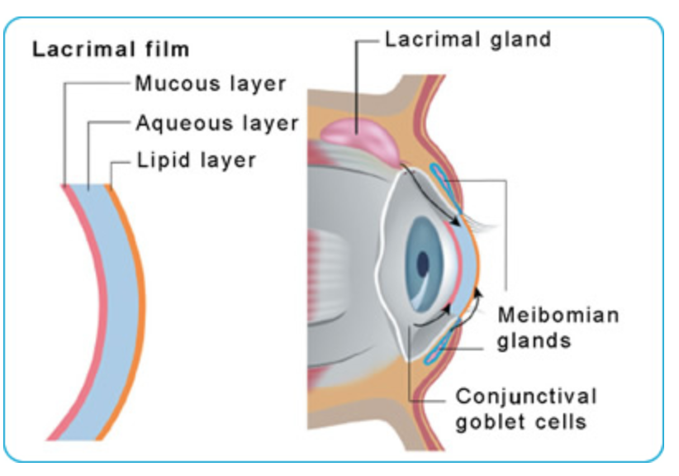
ANATOMY

Slide 16
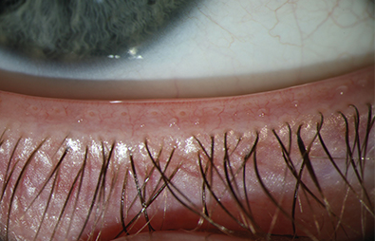
MEIBOMIAN GLAND

Slide 17
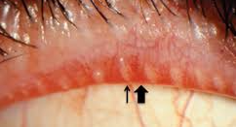
MGD

Slide 18
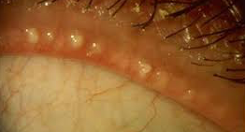
MGD

Slide 19
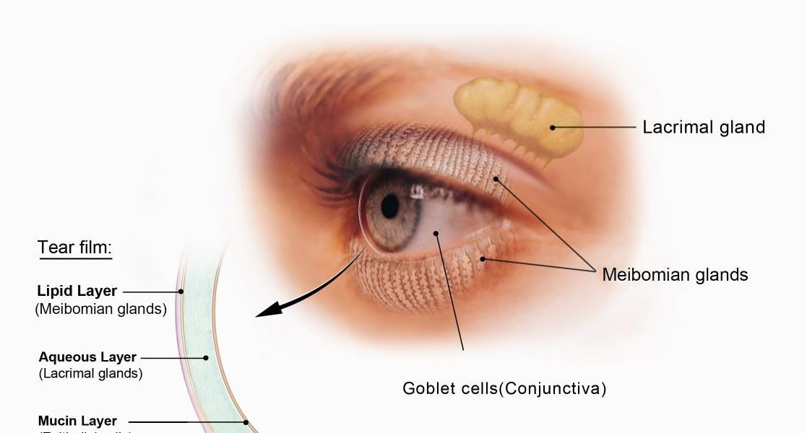
LACRIMAL GLANDS

Slide 20

DRY EYE

Slide 21
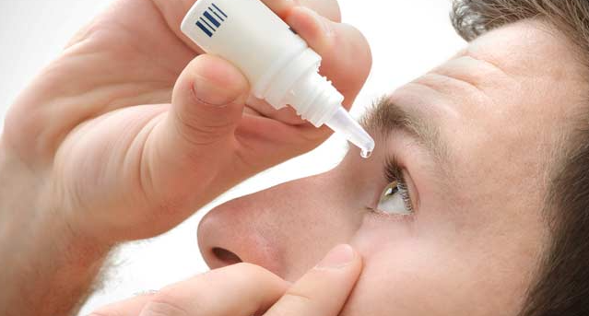
DROP INSTILATION

Slide 22
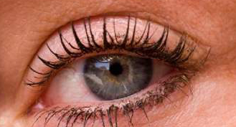
DRY EYE

Slide 23
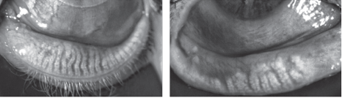
MEIBOMIAN GLAND

Slide 24
Causes, Treatment, Diagnosis of MGD
On both your upper and lower eyelids near to your lashes.
Whenever you blink, the pressure makes these glands to excrete oil.
This oil, in turn, ensures tears do not evaporate too quickly, allowing them to keep the eye moisturized
Some people, however, have Meibomian gland dysfunction (MGD), which means that the glands produce either too much or, more commonly, too little oil.

Slide 25
Causes of MGD
The exact causes of MGD are often not known
Age, with MGD being more common in older people Prescriptions
Retinoic acid (acne treatment)
HORMON for menopause
Antidepressants,
Antihistamines,
Anti-androgen medication (used to treat prostatic hypertrophy).

Slide 26
Causes of MGD
Endocrine disorder, like being pregnant or going through menopause.
contact lenses Wearer for too long
disorders such as
acne
atopic
rosacea,
psoriasis,
rheumatoid arthritis and
Sjogren’s syndrome.

Slide 27
Refractory dry eye
treated with a combination of
IPL +MGX
Results in a significant improvement in dry eye symptoms and meibomian gland function

Slide 28
safety glasses + adhesive shields
Patient should wear safety glasses and use
adhesive shields to keep the eyelids closed during treatment

Slide 29
PROCDURE
1. Patented disposable IPL eye pads (Sperian Inc.) are placed over closed eyes to cover the area completely.
2. Ultrasound gel (Parker Laboratories) is placed on the patient's face from tragus to tragus including the nose. The patient's skin area receives one full pass with overlapping flashes to ensure treatment of the entire area.
3. Following the initial pass, the patient receives more ultrasound gel, and a second pass is performed.
4. With completion of the second pass, the gel is removed from the face, and the patient is brought to the slit lamp where a drop of 1% proparacaine is administered and a gland expression is performed (using a sterile cotton tip applicator).

Slide 30
PROCDURE…
5. The cotton tip is placed on the palpebral conjunctiva in the area of the meibomian gland and the physician places a finger on the skin next to the same gland.
6. The patient is told to look up, and while applying gentle continuous pressure with both the cotton tip and the finger, the gland is expressed for 30 sec.
7. The procedure is repeated over the length of the lower lid on both sides.
8. Upper lid expression follows using finger pressure, and is performed with the patient looking down. If upper lid glands are unresponsive to this technique, a sterilized cotton tip is used as described. Once the glands have been expressed, the patient is given either a drop of topical steroid or a nonsteroidal anti-inflammatory drug (NSAID).

Slide 31
HOW DOES IT WORK?
E-EYE
The « flashed » areas (suborbital and zygomatic region) are the areas where the parasympathetic nerve passes
train of pulse leads to the nerve
Causes micro gradient of temperature between the inner and the outer layer of the myelin sheath

Slide 32
microgradients
This micro gradient of temperature
triggers the liberation of neurotransmitters

Slide 33
parasympathetic
the parasympathetic nerve is connected to the Meibomian gland
The neurotransmitters released will then be able to interact with the Meibomian gland
stimulating the secretion and the
contraction of the gland.

Slide 34
The treatment effects is cumulative and lasts
1 week after the 1st session
2 to 3 weeks after the 2nd session
6 months to 2 years after 3 to 4 sessions

Slide 35
Pulse delivery
The sculpted pulses are delivered under the shape of train pulses.
The energy, spectrum and time period are precisely set to stimulate and unblock the Meibomian glands
in order to return their normal functions.

Slide 36
The E>Eye is easy to use
Starts in a few seconds : No pre-heating required.
Compact : Fits in any practice space.
Affordable: doesn’t require maintenance, low running costs.
Medically certified

Slide 37
PREVENTION
The E>Eye is not only a great medical device for treating people suffering from MGD but
it is also a great tool for prevention

Slide 38
Treating your customers once a year
with an E>Eye treatment will
decrease the risk of getting dry eyes and complications associated with it.

Slide 39
TREATMENT
1-Each session only takes 3 to 5 minutes.
2-The skin is cleaned from any make-up or other cosmetics.
3-The ophthalmologist adjusts the goggles on the patients’ eyes to protect them from the intense light generated by the device.

Slide 40
TREATMENT
…
4-A conductive clear gel is applied on the skin for the skin protection and optimum results.
5-A series of 4 flashes are applied under the lower eyelid, from the external canthus to the internal canthus, using the nominal power.
6-Results are immediate and cumulative.

Slide 41
Treatment …
Following an E>Eye treatment
we also recommend to MGX for optimum results.

Slide 42
Consumables available included in the E>Eye pack
Optical cartridge of 500 flashes
Conductive gel (1 L bottle)
Cleaning spray (for optical parts)
Protective glasses
Patches (to cover potential moles under the eyelid)

Slide 43
E.Eye can be used to
improve the comfort of
reduces redness of the eye, etc…
wearing contact lenses,
reliefs pain from watching computers and other screens,

